Slide 1
Data Visualization Best Practices Part 1
Brian Seko, March 2022

Slide 2
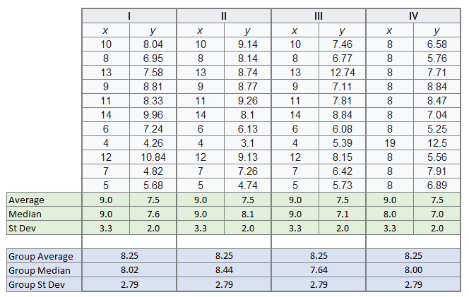
Why Visualize Data?
Visualizations should convey information better than tabular data
Notes:
Visualizations should be used to convey messages from data that we can’t get from a tabular output. When creating a visualization ask yourself “what point am I trying to make”? The delivery of this message should be more effective through visualizations.
A good example of when to visualize data is shown here. These datasets look similar when displayed in a tabular format. Let’s see what happens when we visualize these points…

Slide 3
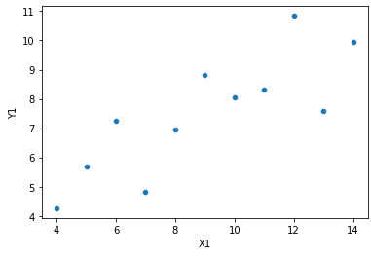
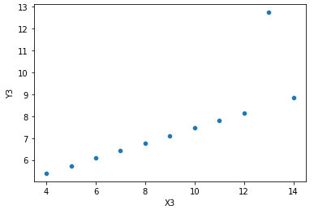
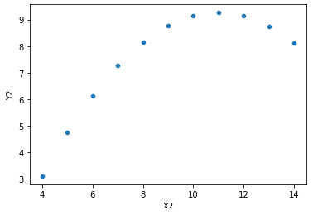
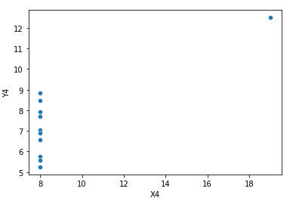
Why Visualize Data?
x2
Notes:
We can see a very different story in each data set that was not as prominent until we used visualizations. Keep this in mind when creating charts avoid complicating an idea - instead, simplify.

Slide 4
A Visual Should be…
Effective
Delivering the facts better than any other method
Expressive
Show all the facts, and only the facts (relevant facts…)
Notes:
When it comes to talking about visuals, two tenants should always be followed: a chart should be both expressive and effective. If you achieve this, any visualization you create will accomplish your goals.

Slide 5
Data Types
Quantitative – information that can be quantified (a number)
“How much”, “how many”, “how often”
Can take an average or median
Continuous data – has an unspecified number of possible measurements between two points
A ruler
Timeseries
Discrete data – has a limited number of possible values
Number of patients in the ICU right now
Ordinal – information has a natural order, and the order is important
Months of the year
Nominal - information that is divided into groups where order is not important
Types of fruit

Slide 6
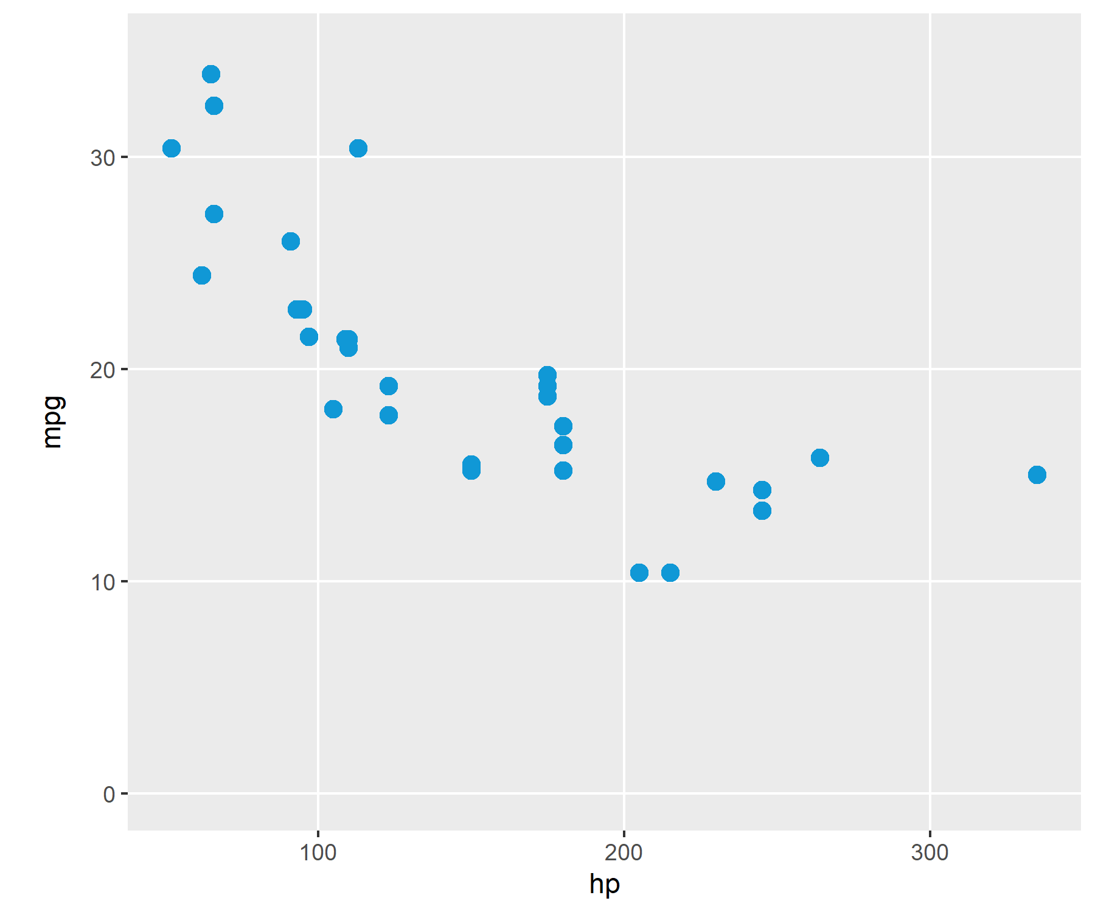
Scatter Plot
Use to compare two continuous variables.

Slide 7
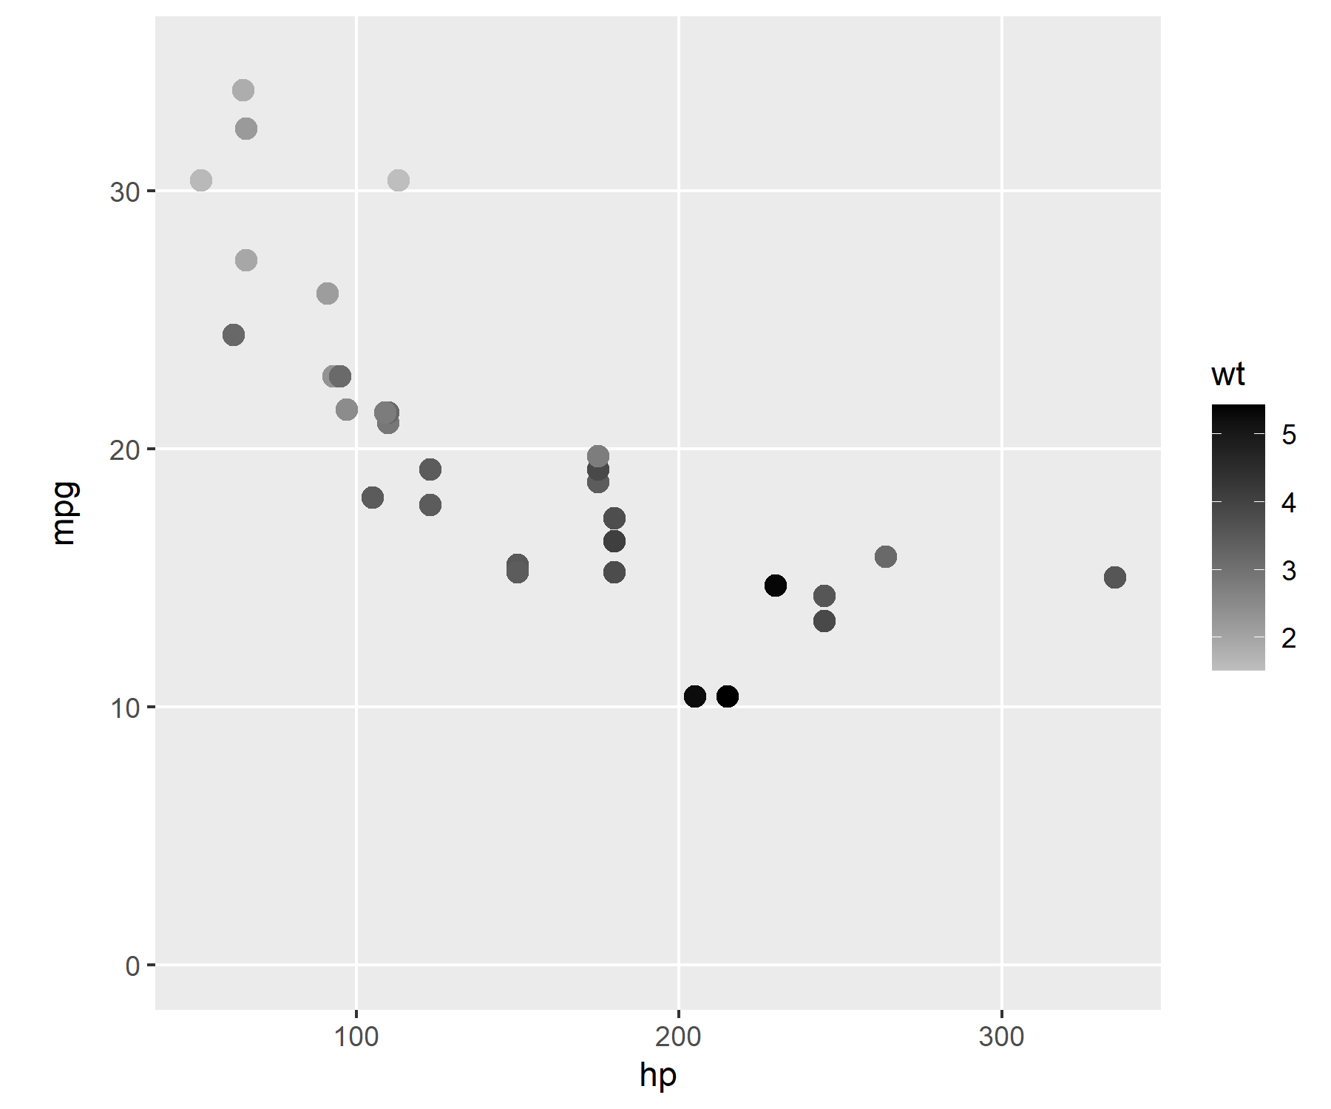
Scatter Plot
Color Saturation can be used to encode a third continuous variable

Slide 8
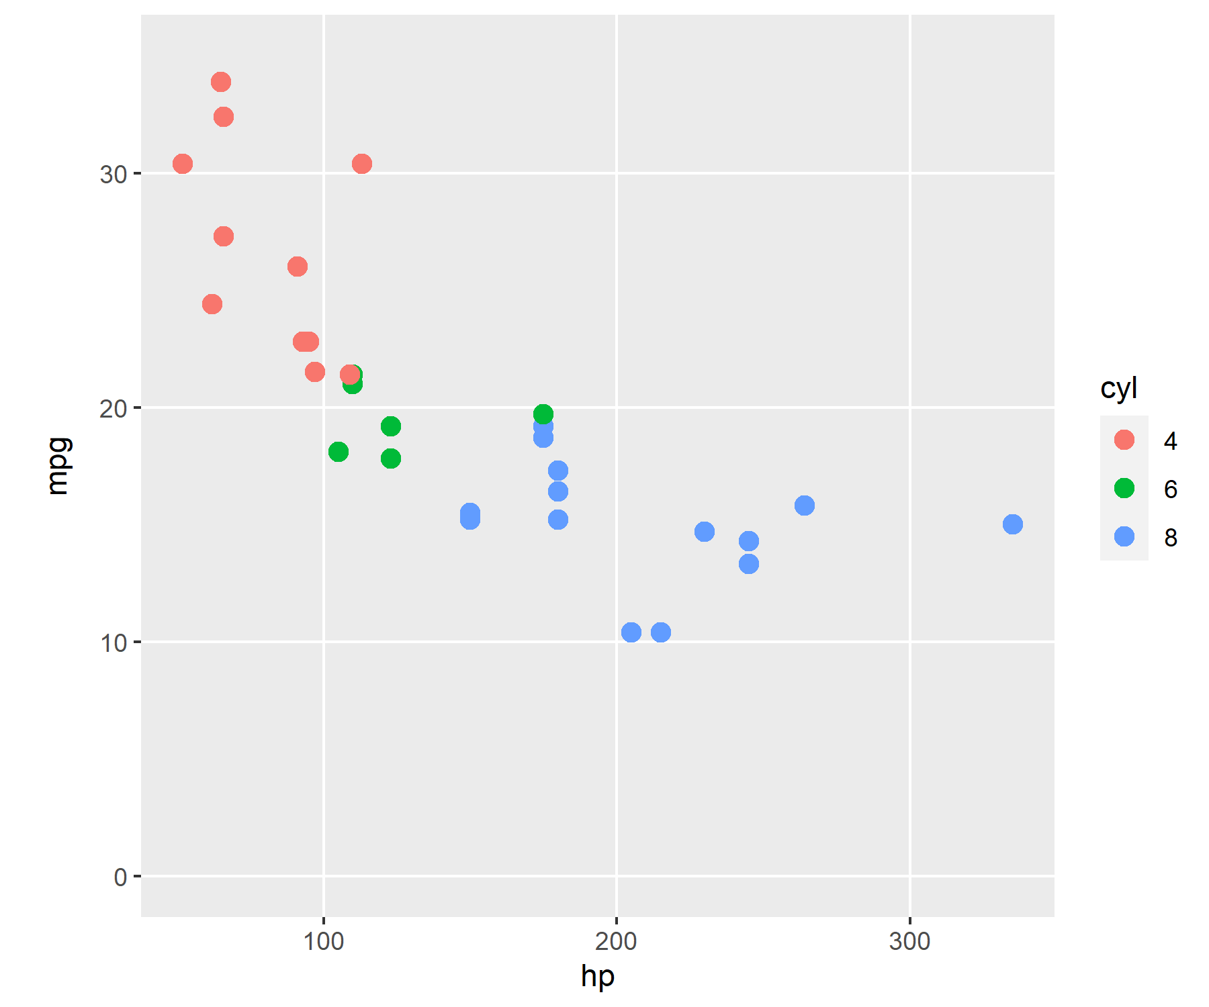
Scatter Plot
Color Hue can encode a discrete variable

Slide 9
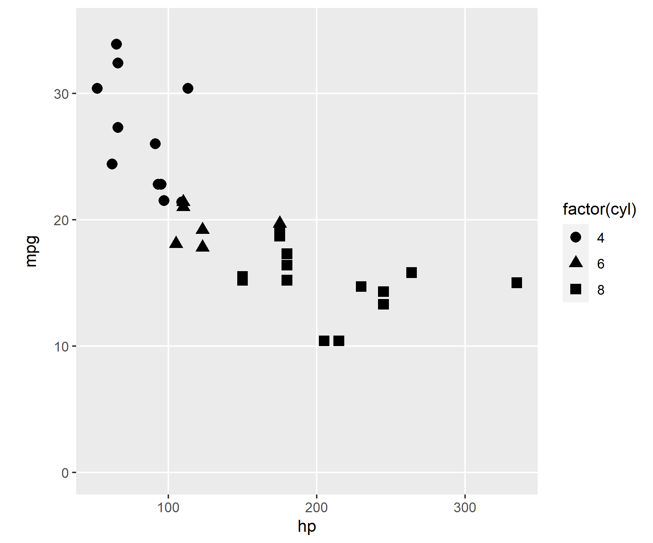
Scatter Plot
Don’t use shapes to encode additional variables!

Slide 10
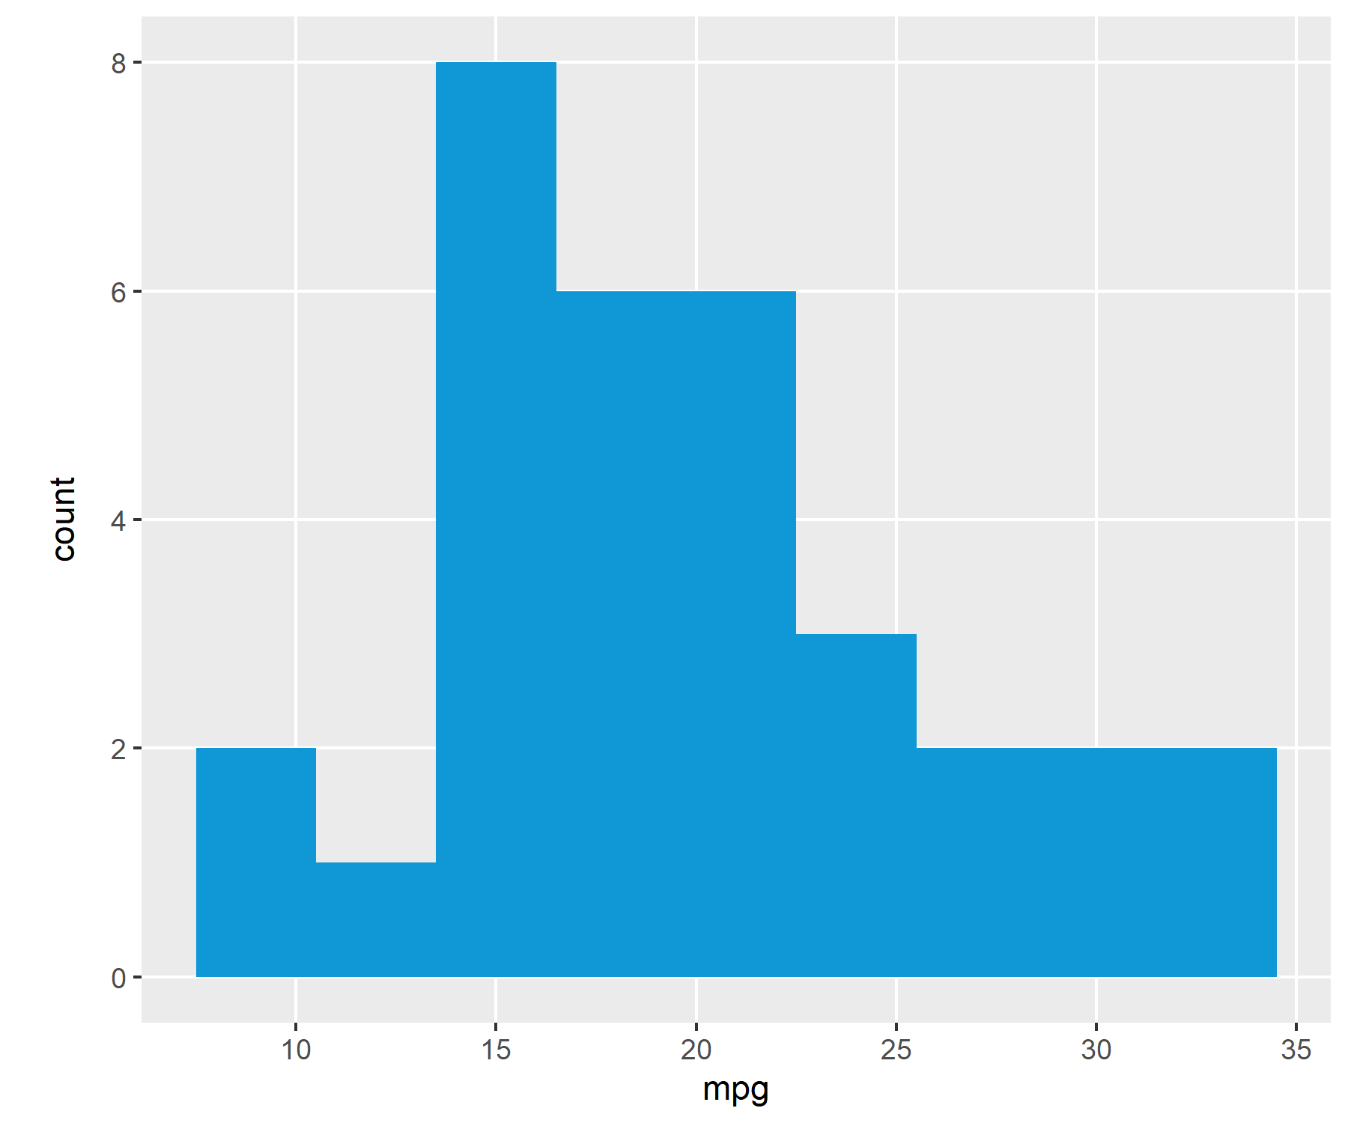
Histogram
Histograms are best for creating discrete buckets for a single variable
Additional variables should not be encoded

Slide 11
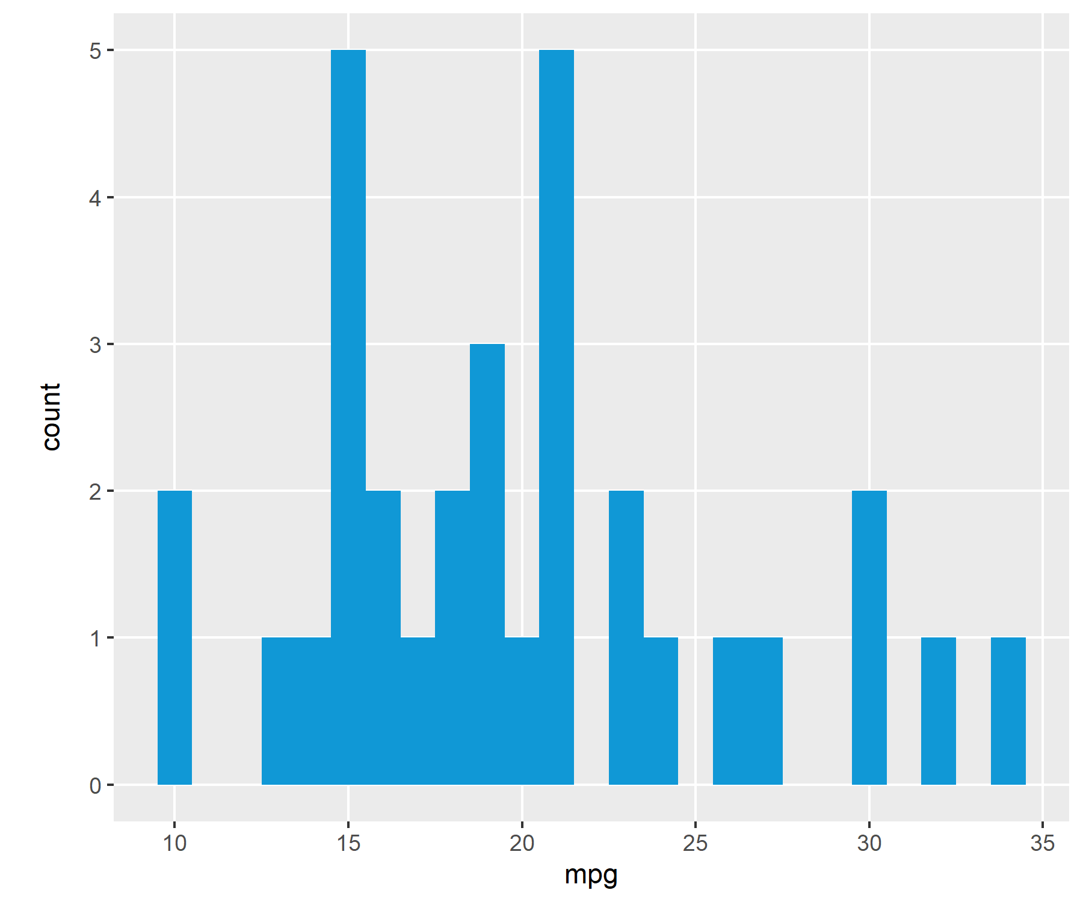
Histogram
Rule of thumb: bin size can vary, but bins should touch

Slide 12
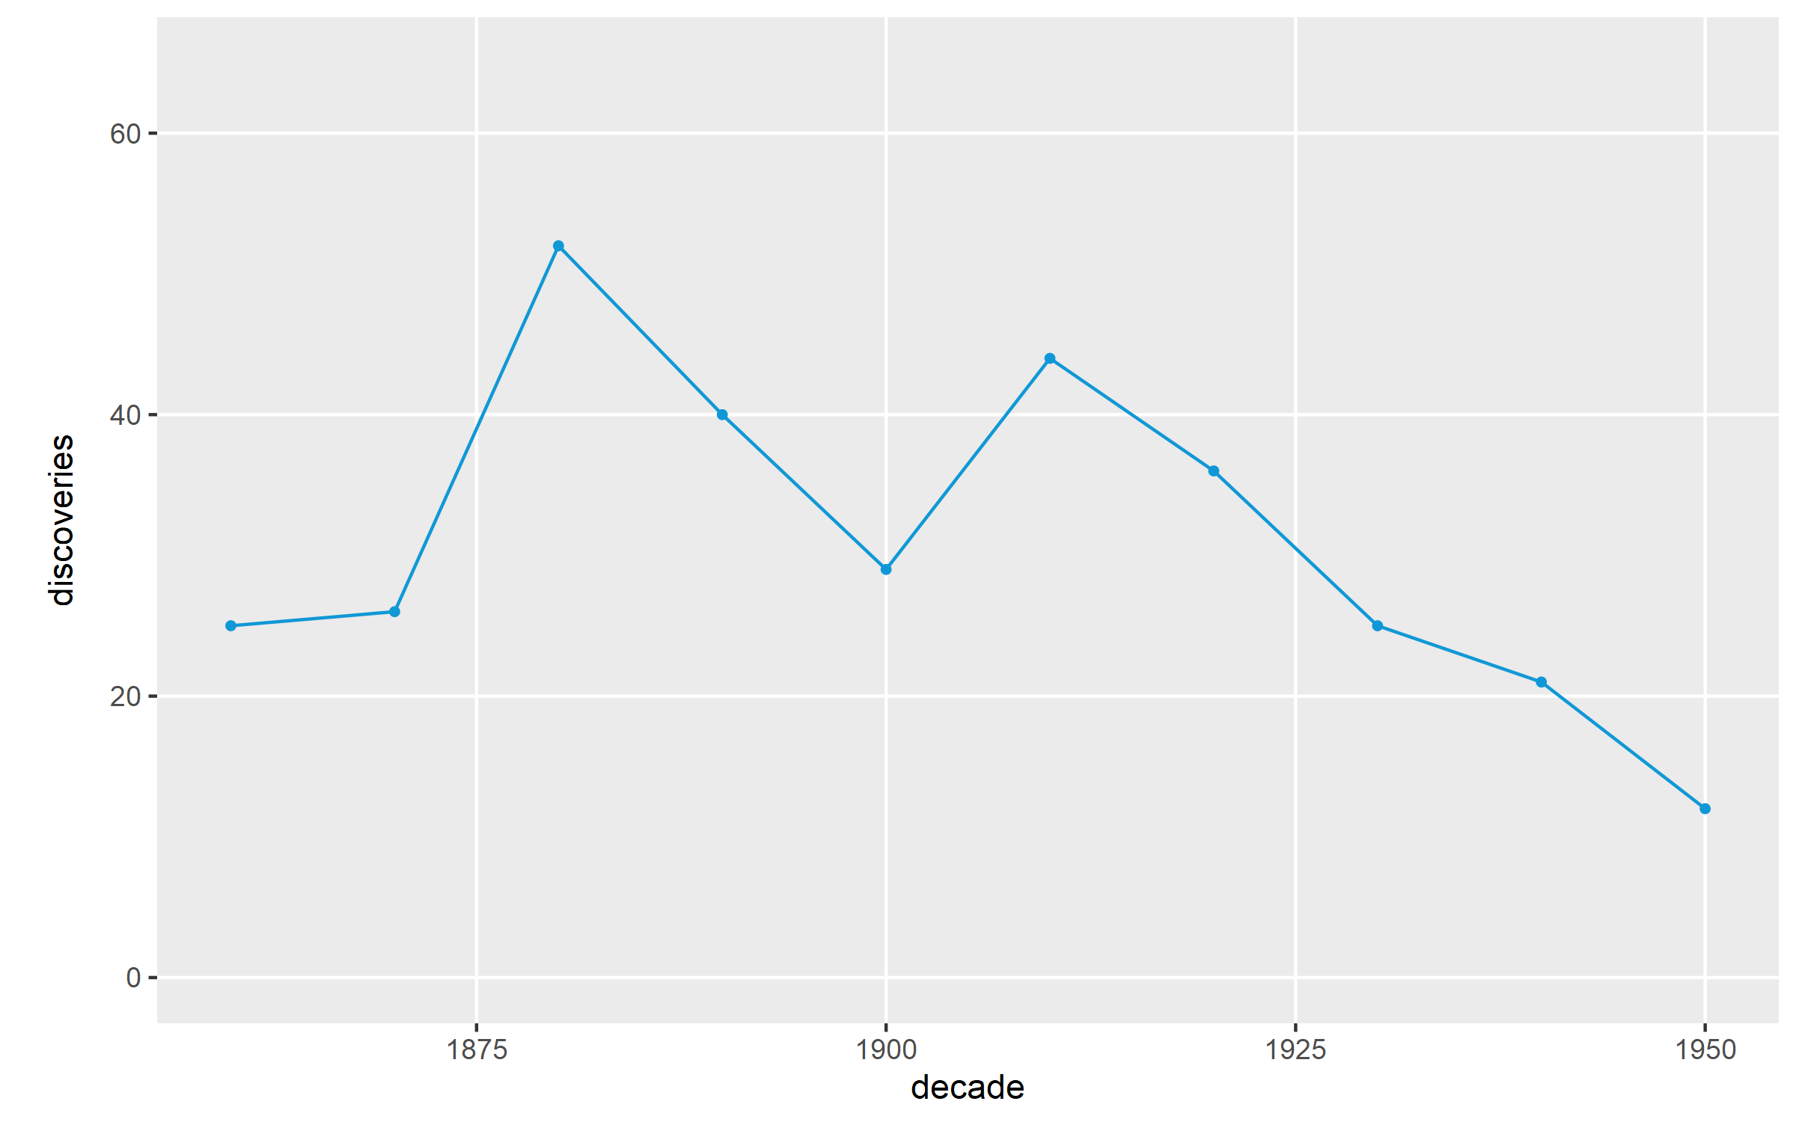
Line Chart
Used when data is connected, most often used with timeseries data. Line should emphasize trends.

Slide 13
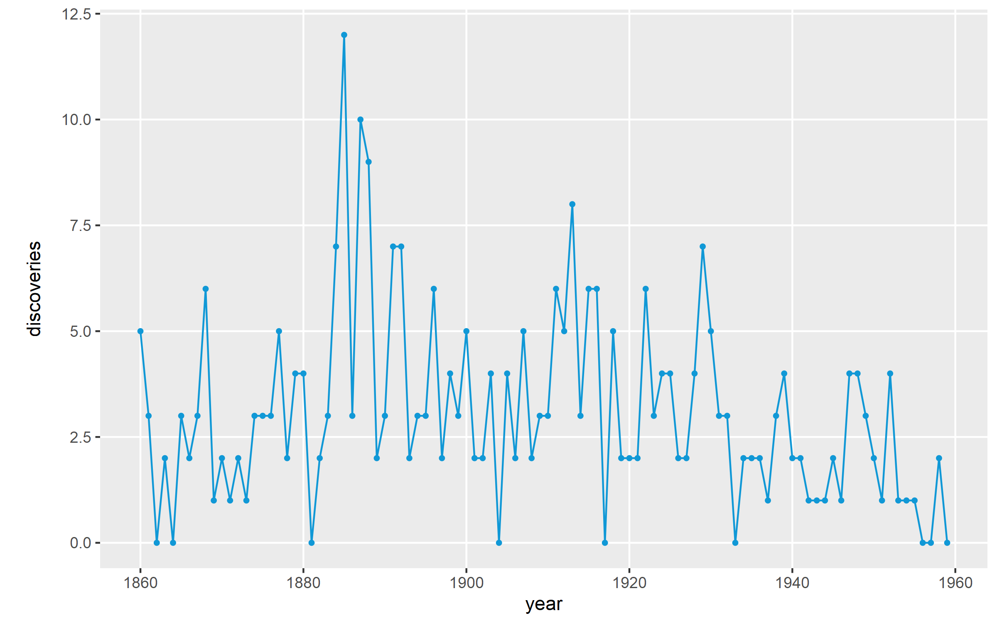
Line Chart
Avoid jagged charts that can’t show a trend.

Slide 14
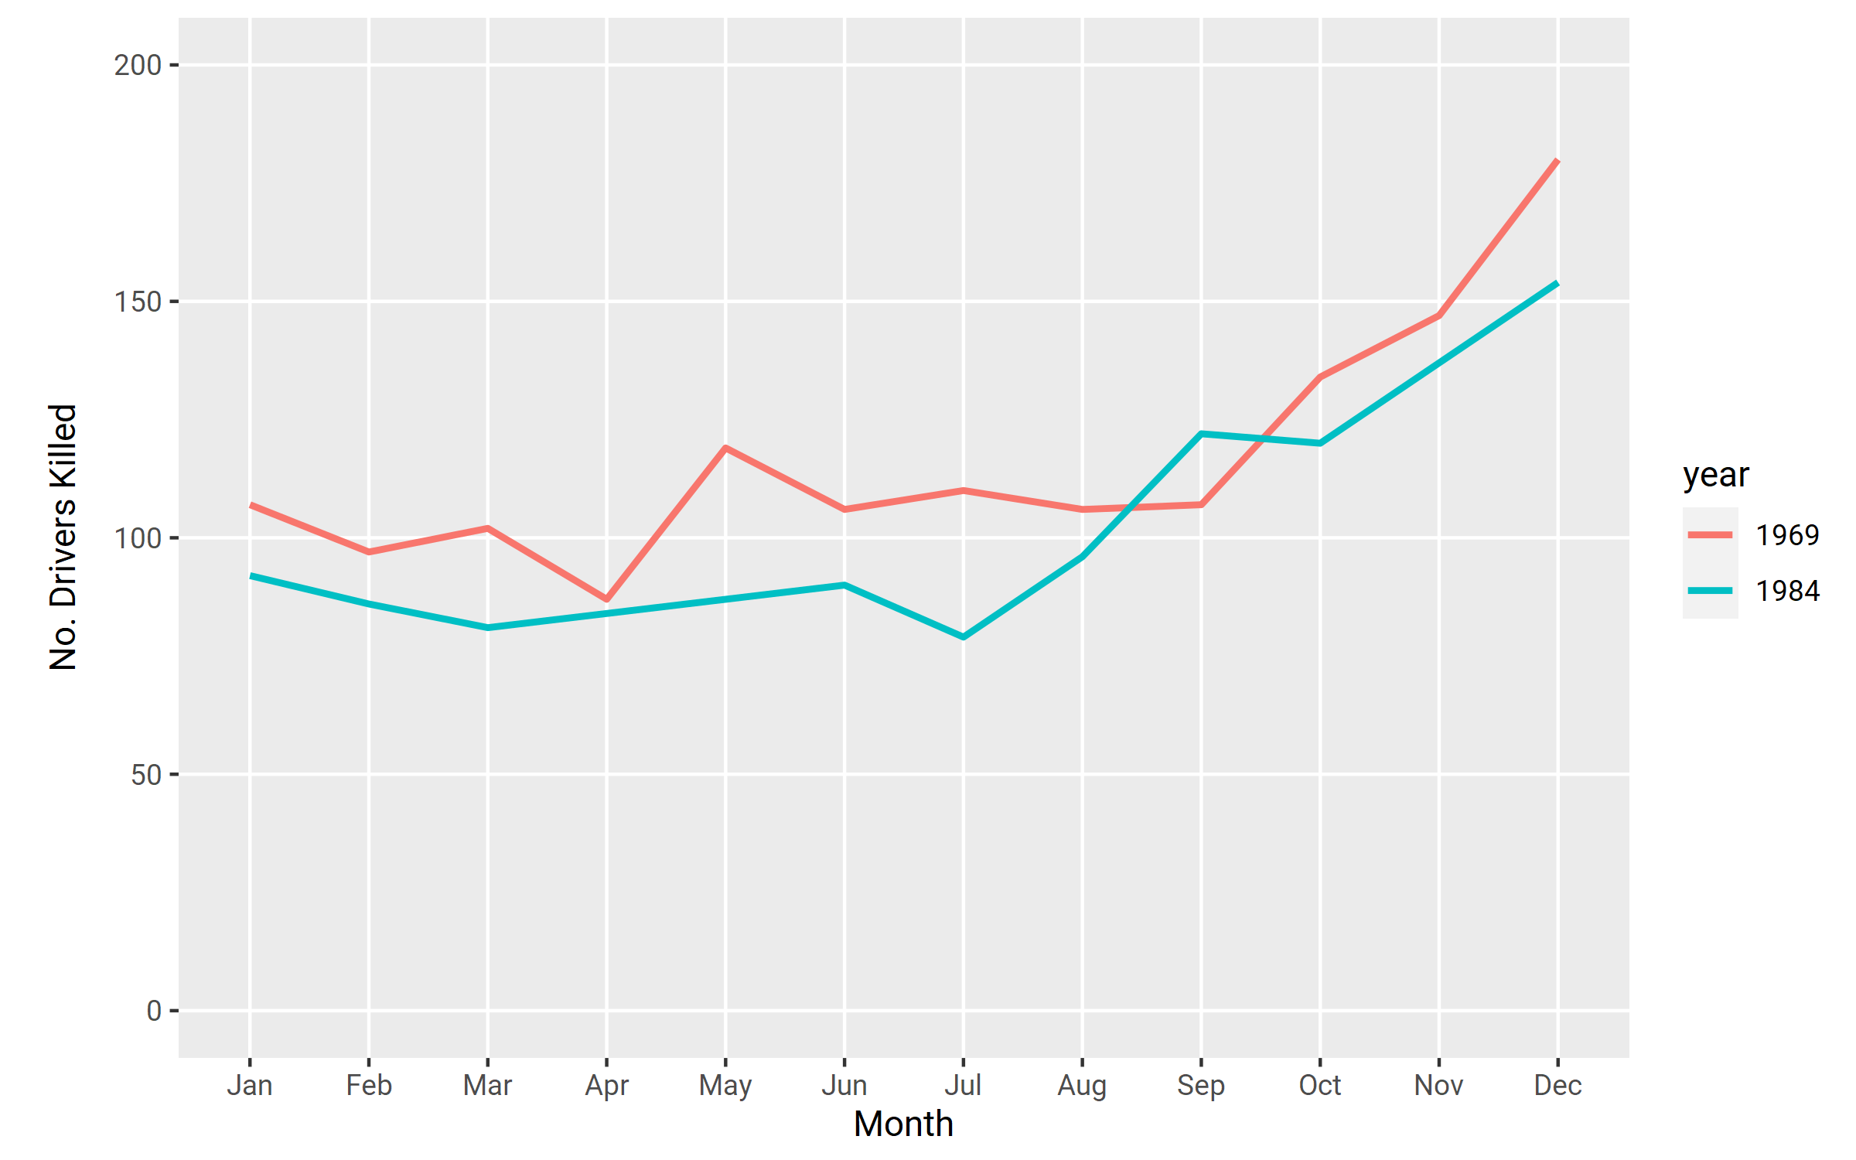
Line Chart
Line charts are effective at comparing trends. Example: different years.

Slide 15
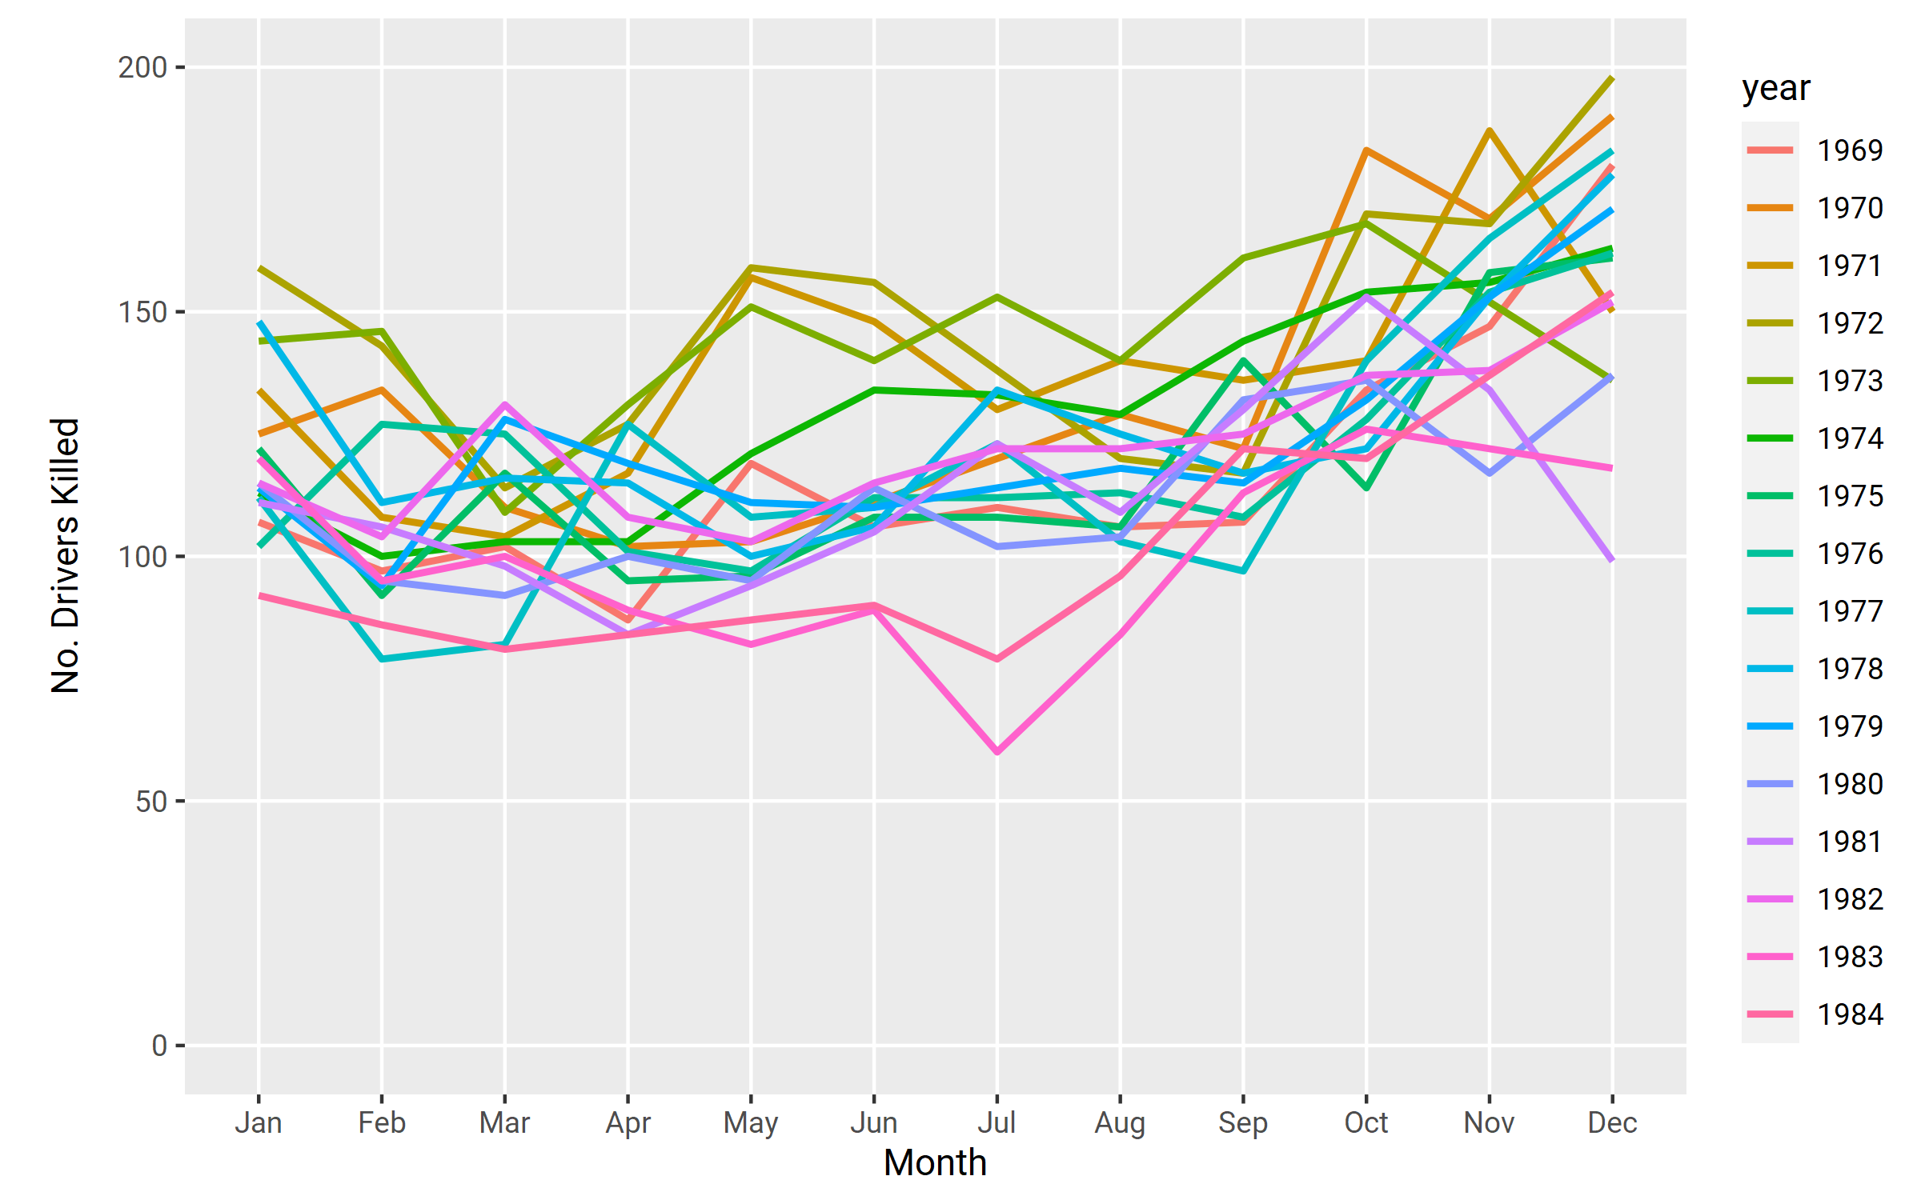
Line Chart
Avoid making too many comparisons.

Slide 16

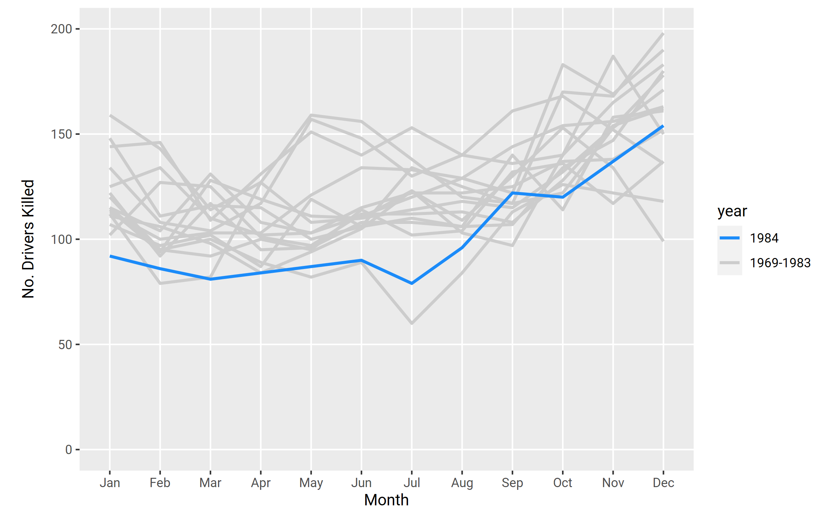
Line Chart
If you need to make many comparisons, color should be used to highlight the meaningful trend.

Slide 17
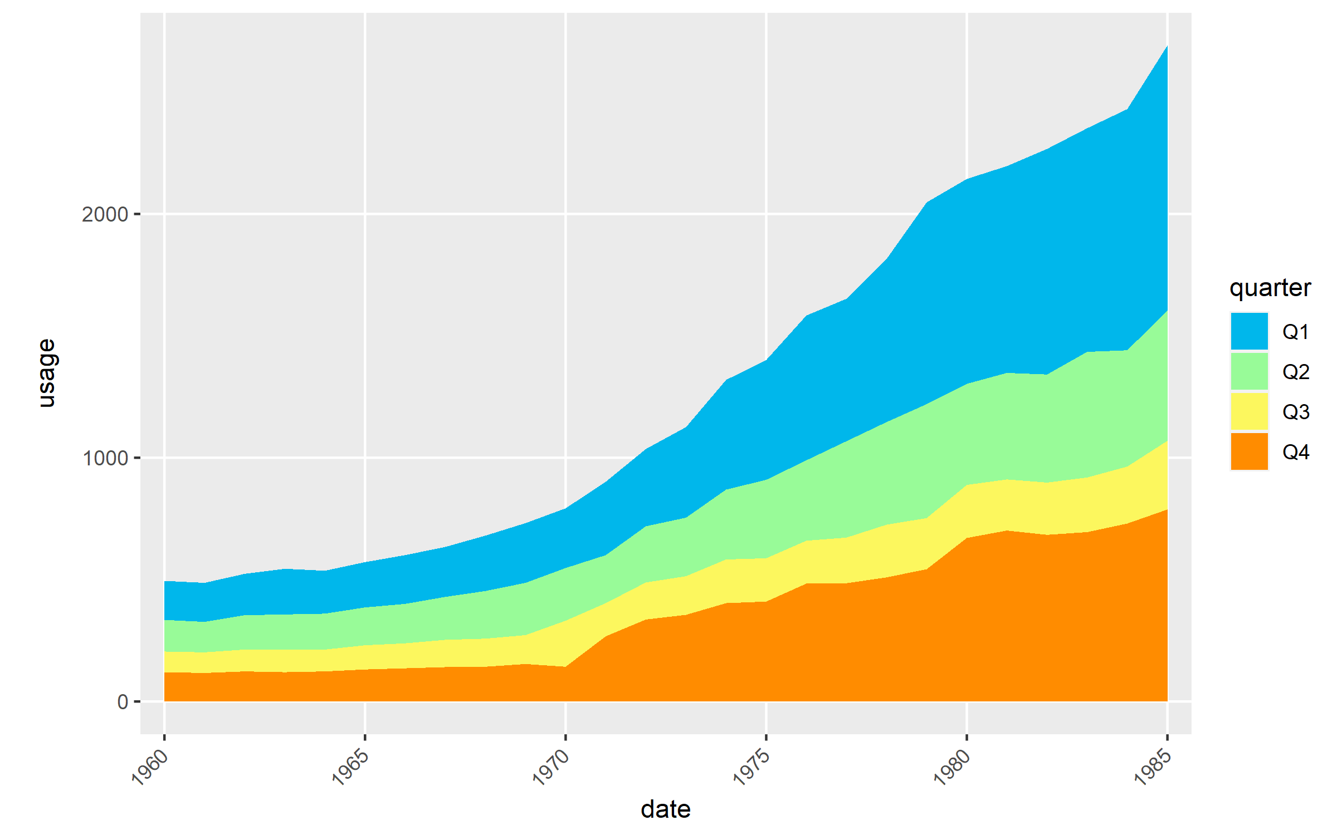
Area Chart
Shows how a total and its shares developed over time. Used with continuous connected data.

Slide 18
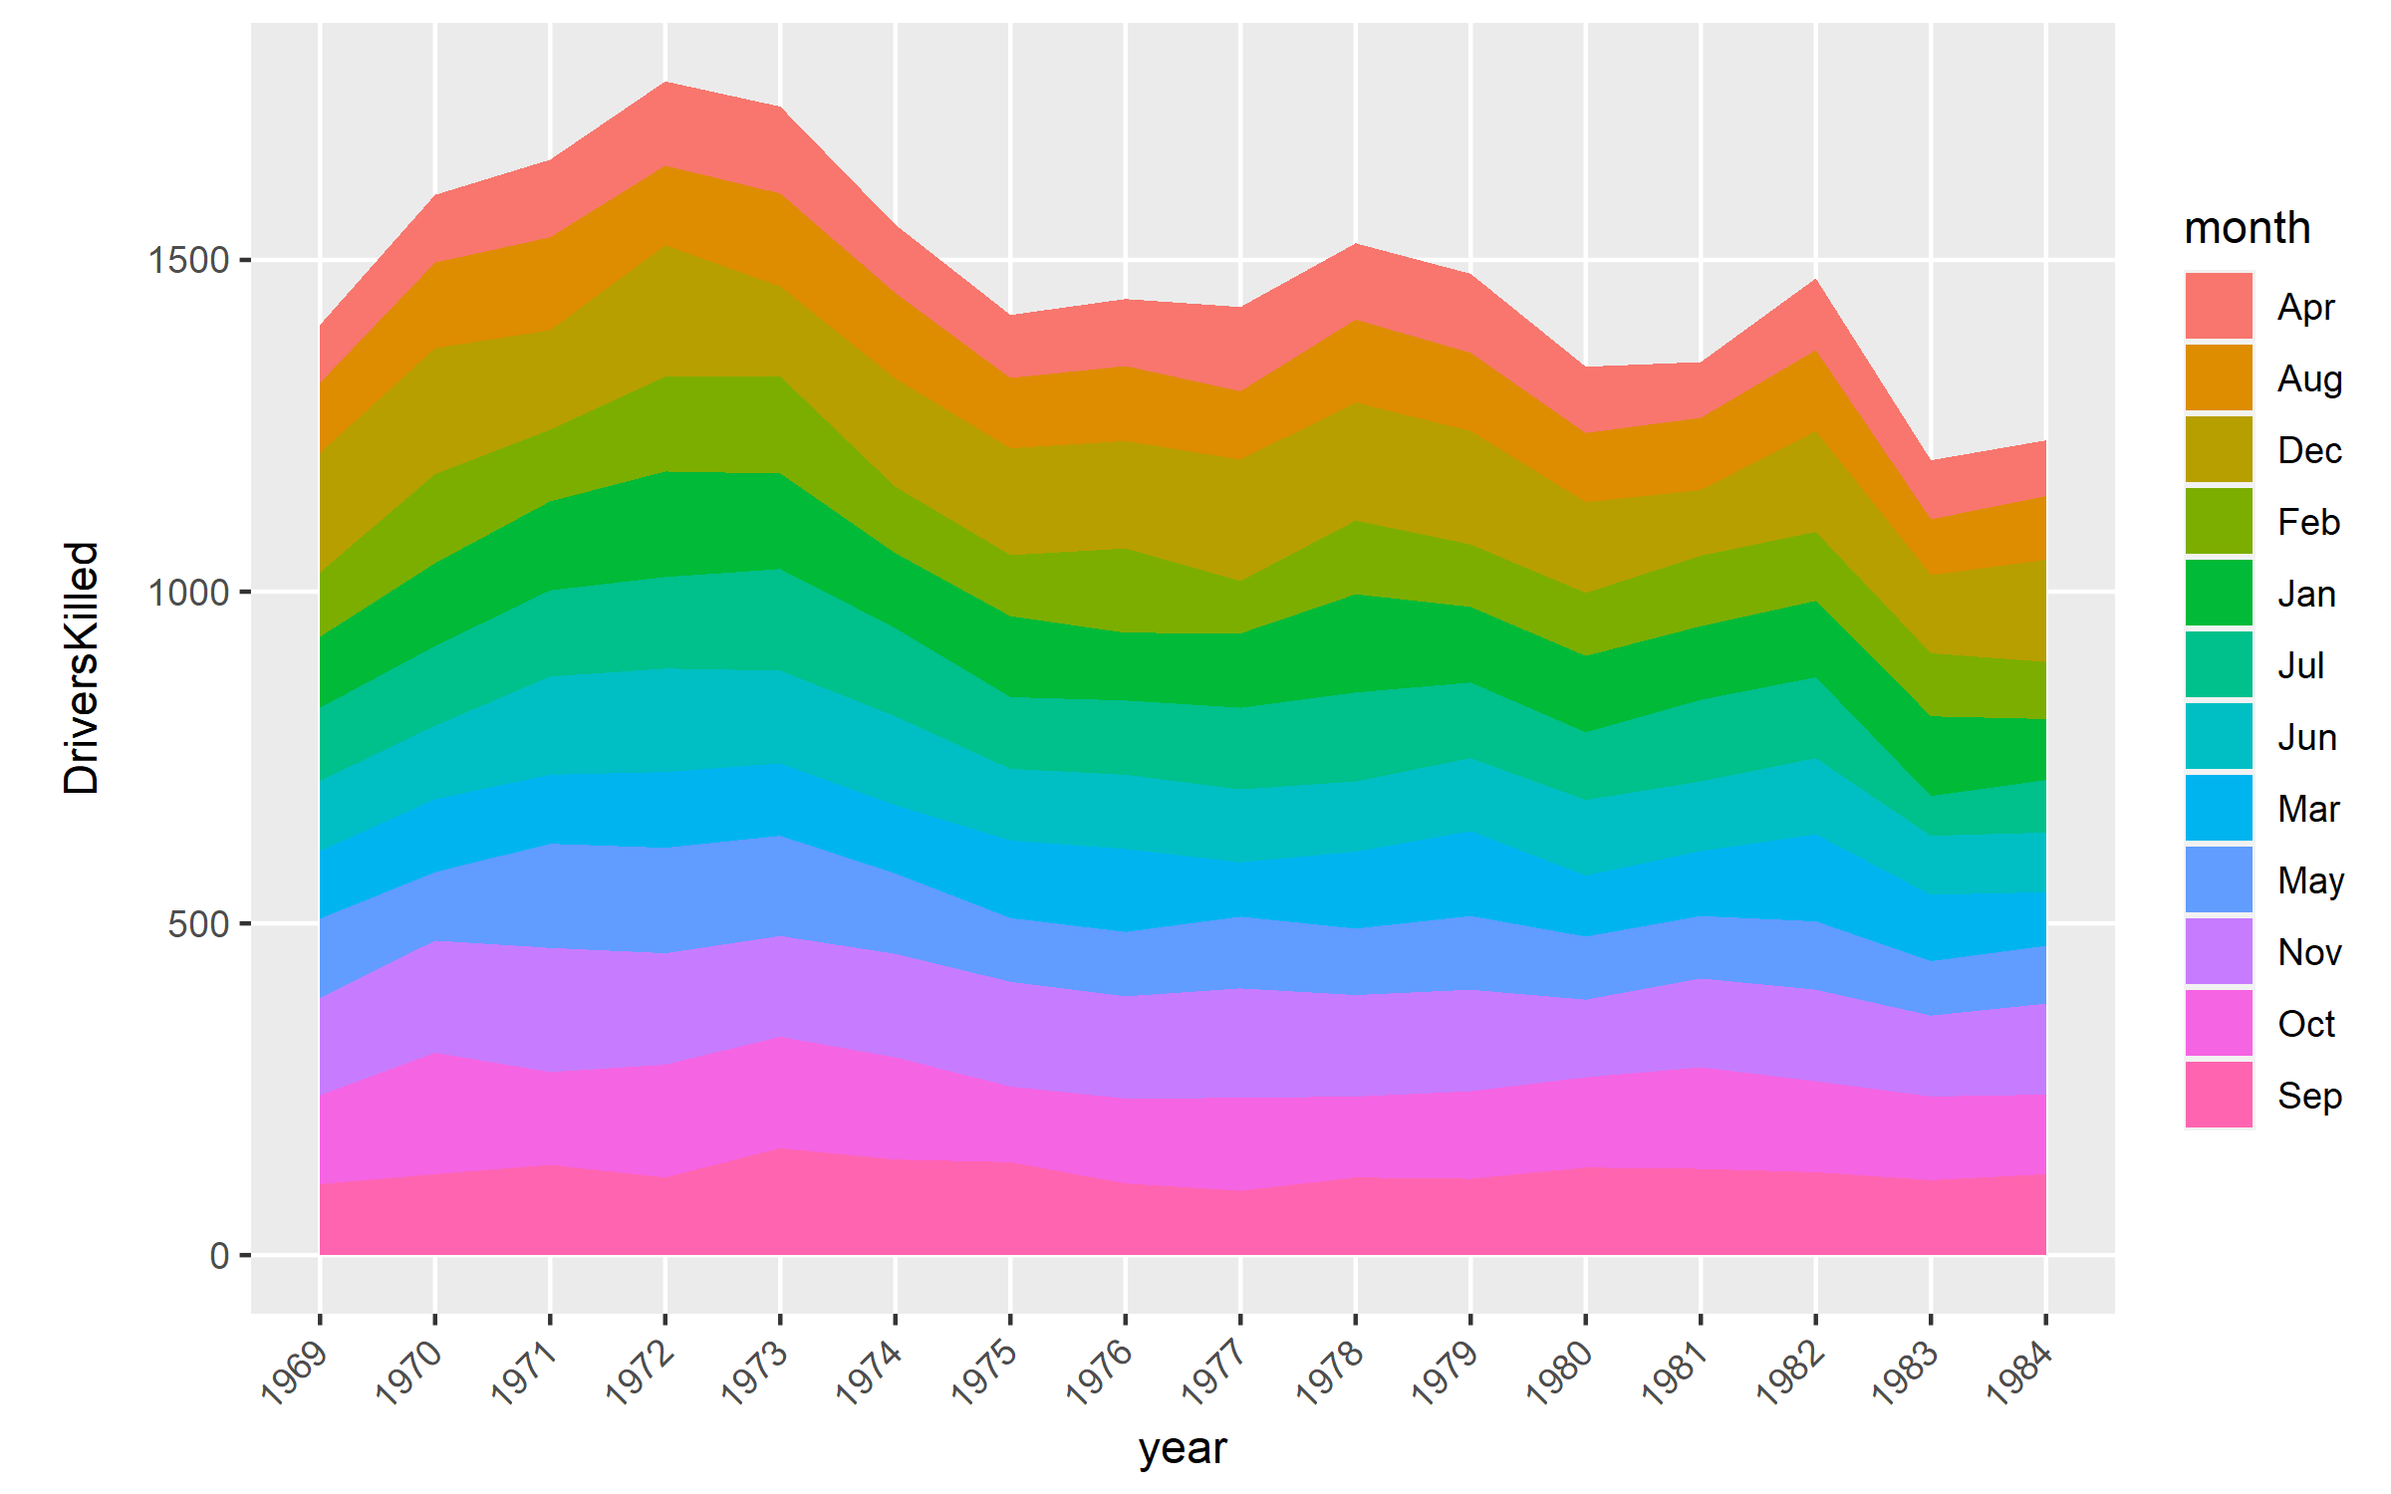
Area Chart
Same rules as a line chart, avoid using if you have a lot of categories.

Slide 19
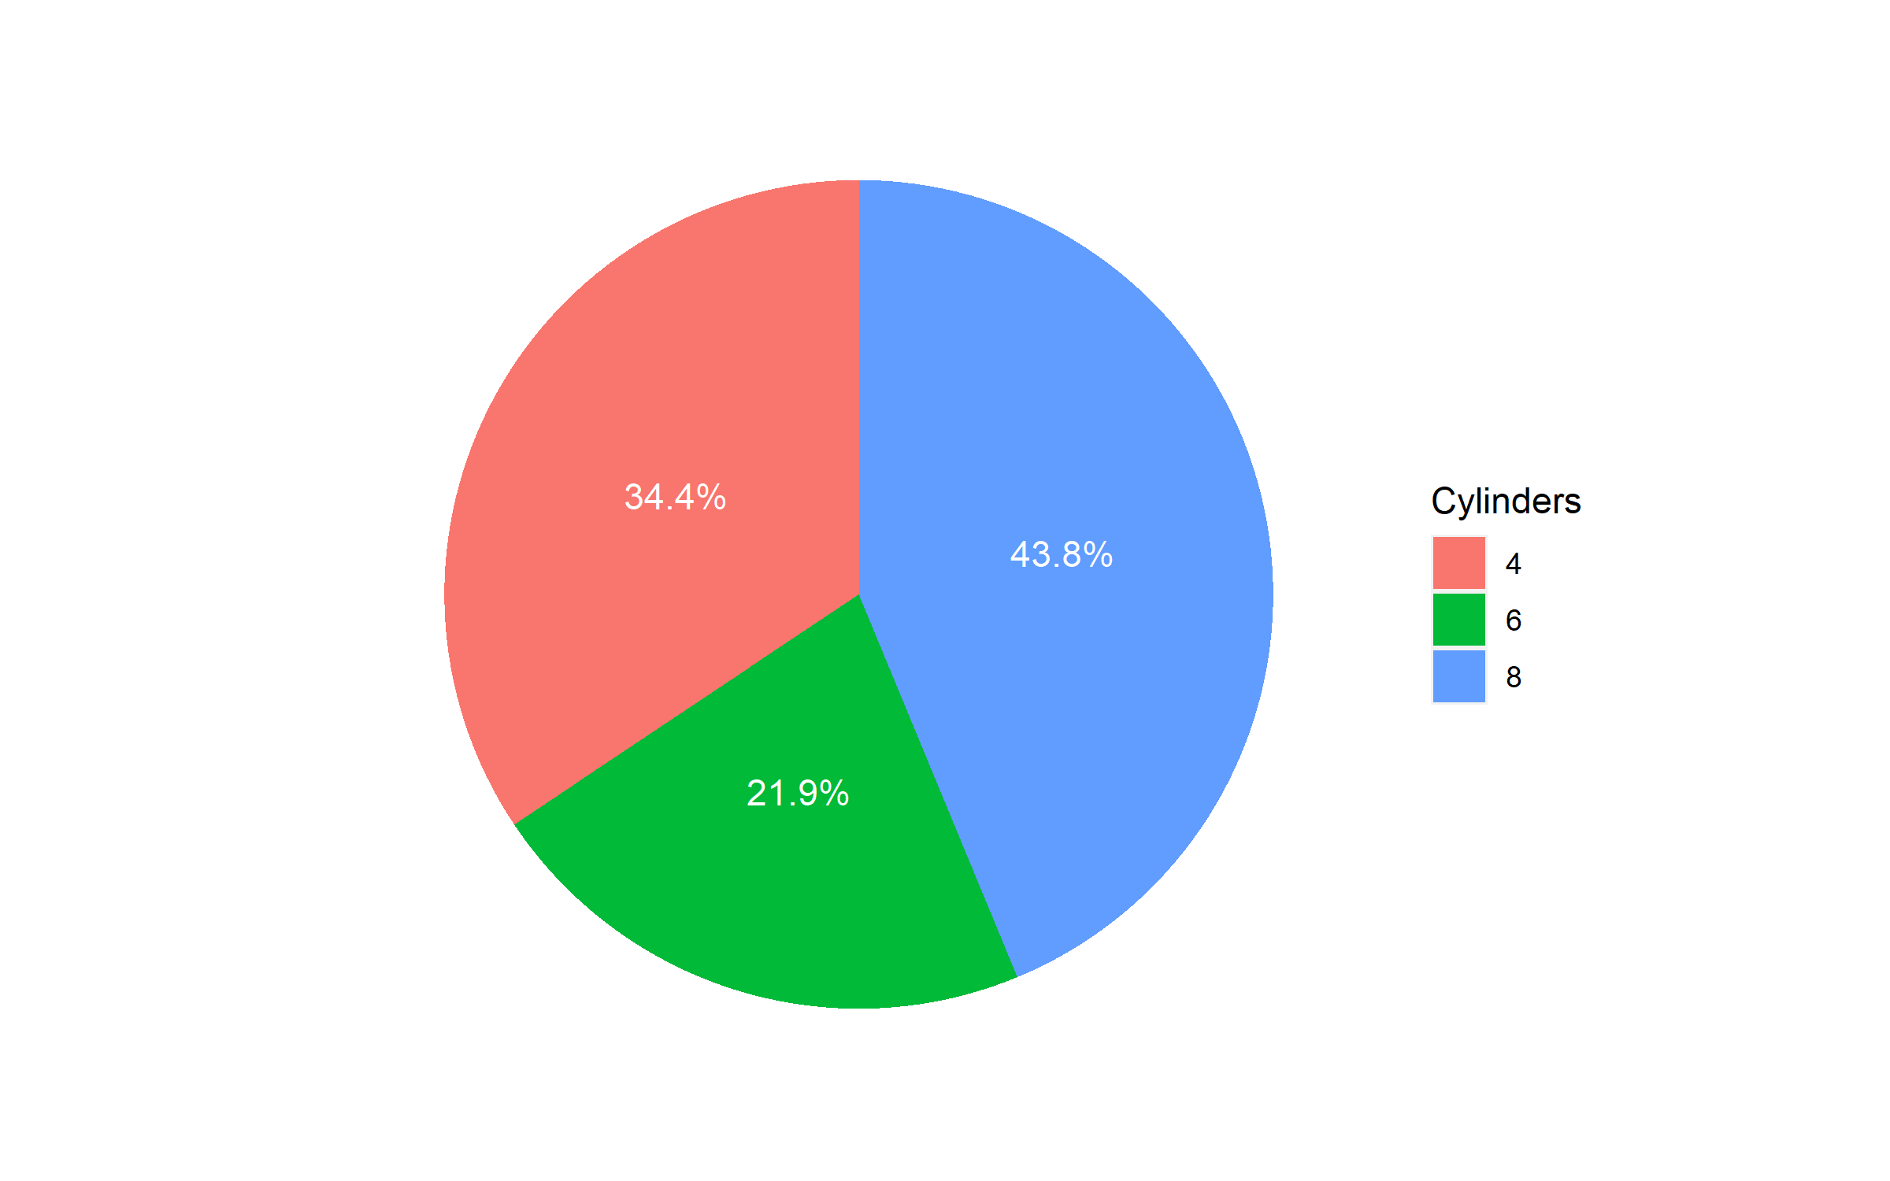
PIE Chart
Helpful for showing the relationship of parts to the whole.
Only helpful with limited categories.
Use color hue instead of saturation to distinguish categories.

Slide 20
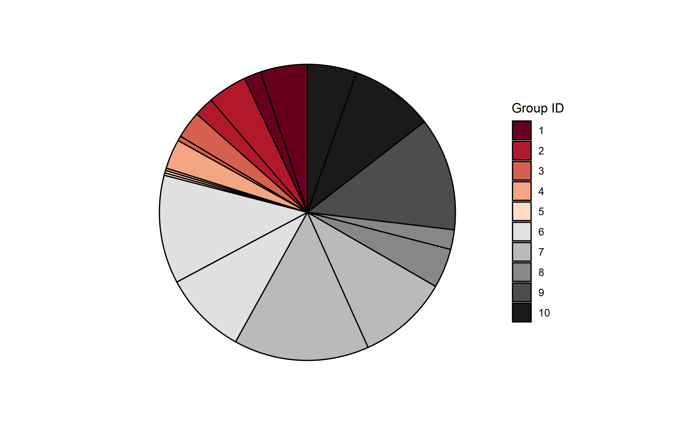
PIE Chart
Avoid using when there are many categories.

Slide 21
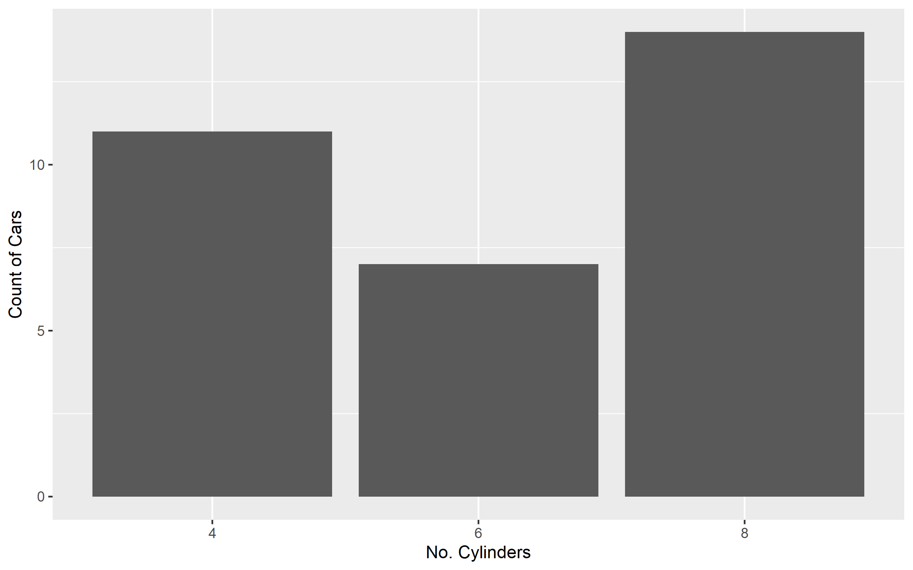
Bar Chart
When in doubt, you can likely use a bar chart. Great for continuous and discrete data.

Slide 22
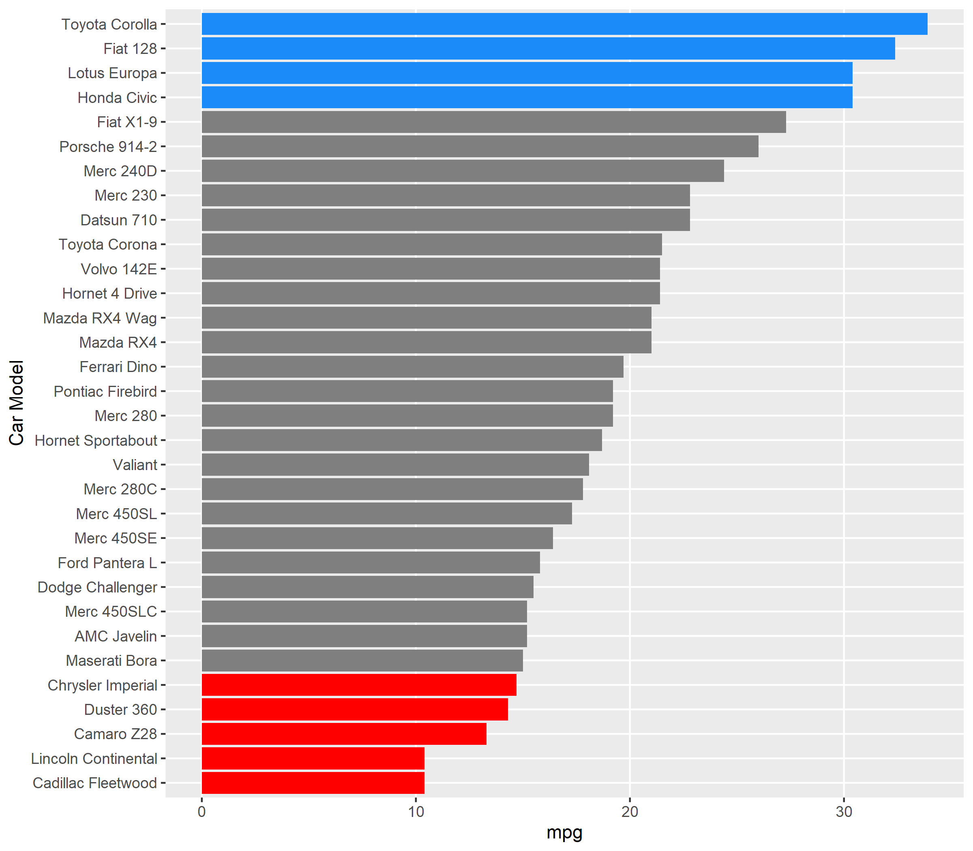
Bar Chart
When in doubt, you can likely use a bar chart. Great for continuous and discrete data.

Slide 23
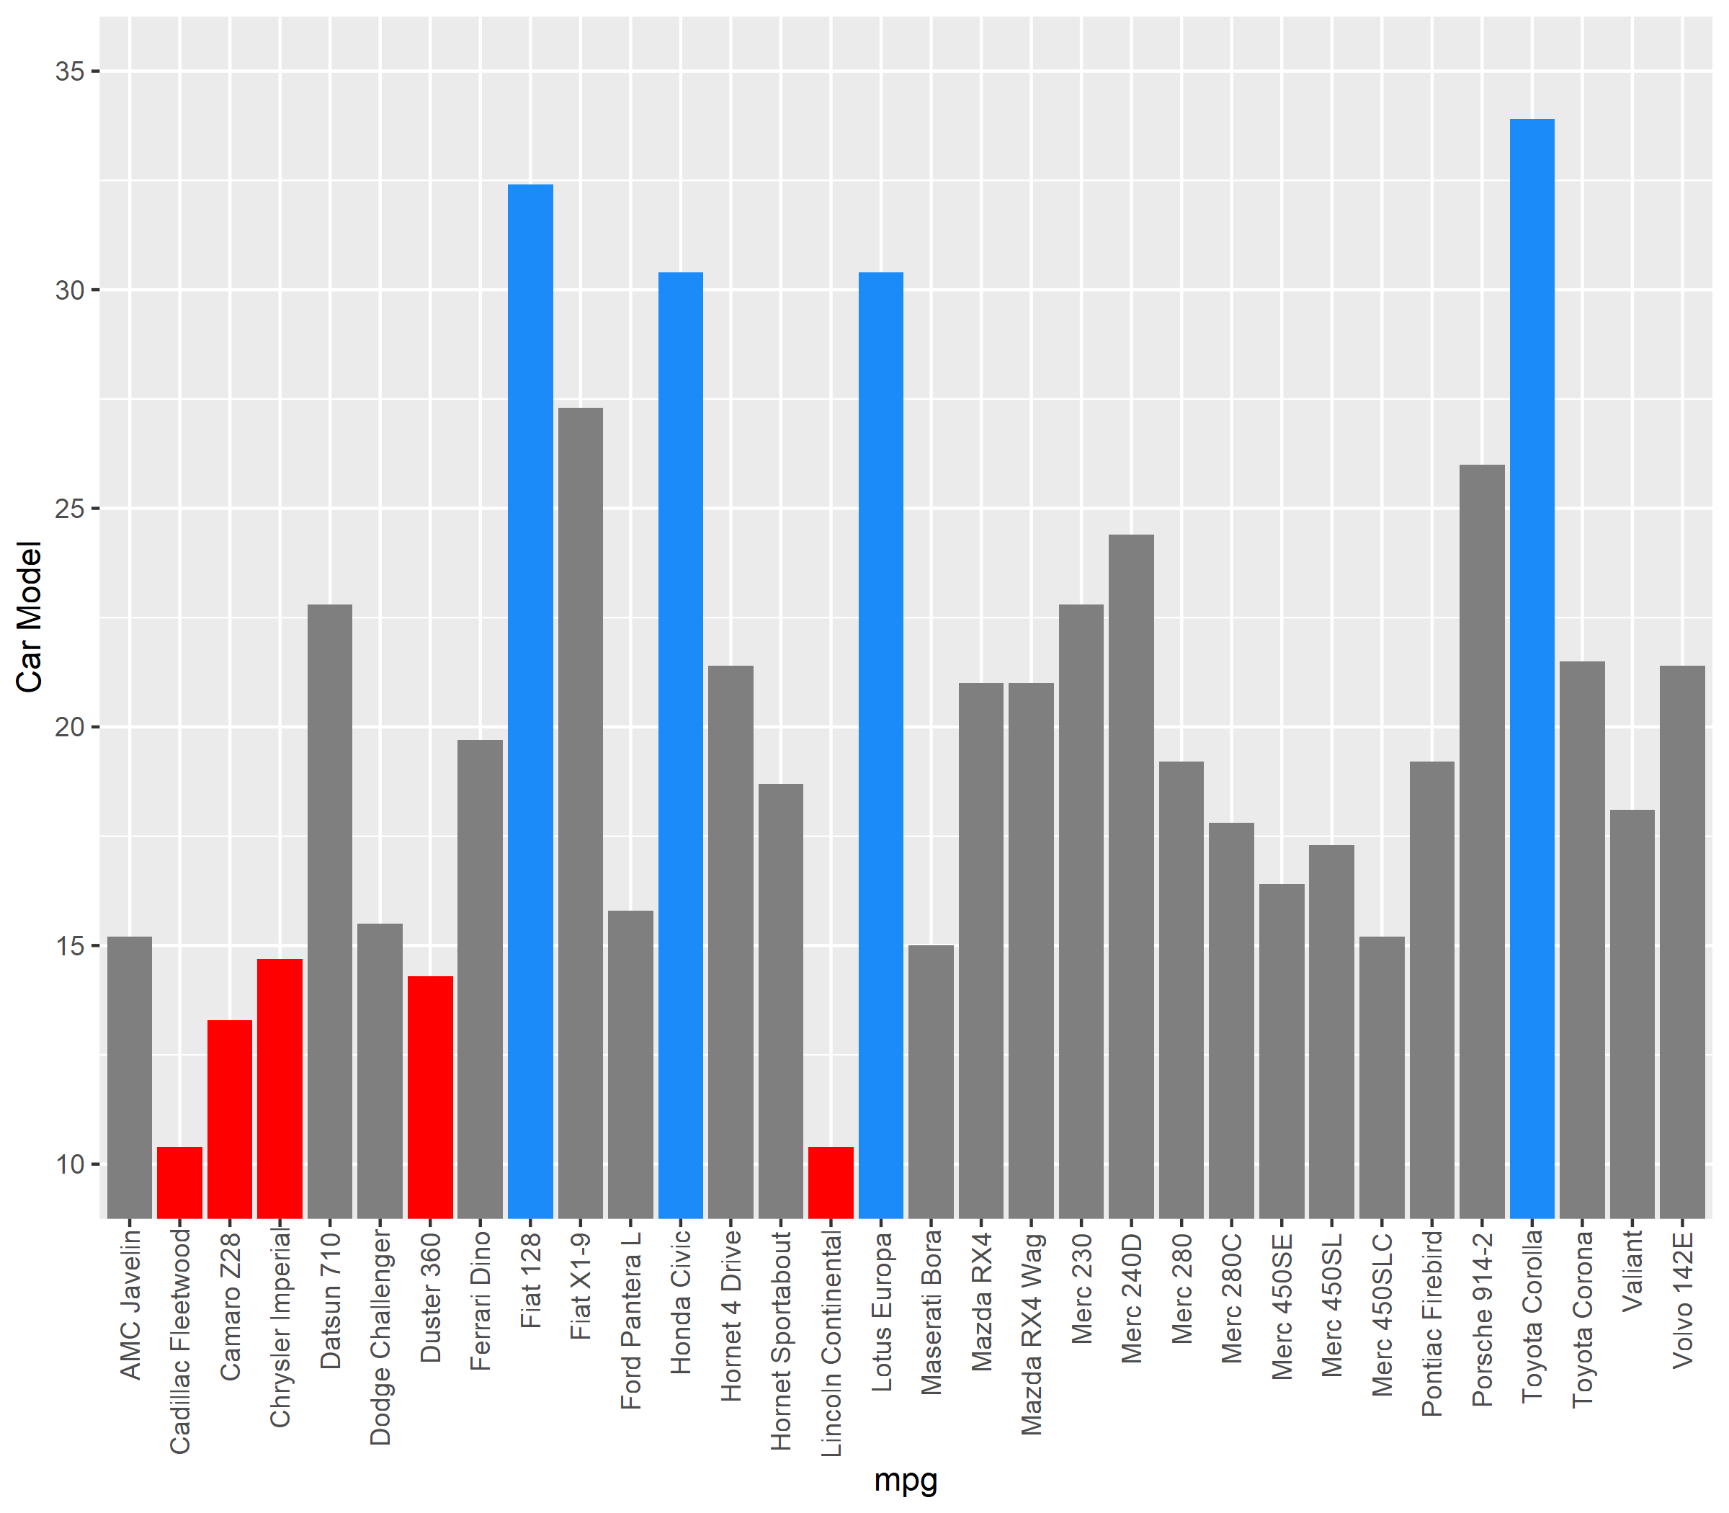
Bar Chart
Unless you have ordinal values, order in ascending/descending order.
Keep axis labels readable by rotating the chart.
Do not truncate scales.

Slide 24
Visual Standards
 | Quantitative | Ordinal | Nominal
Continuous | Scatterplot Histogram | Line Chart Area Chart | Bar Chart Stacked Bar Grouped Bar Pie Chart
Discrete | Histogram | Bar Chart Stacked Bar Grouped Bar

Slide 25
Visual Standards
 | Quantitative | Ordinal | Nominal
Continuous | Color Saturation | Saturation | Color
Discrete |  | Position Color | Color /Texture

